Slide 1
This presentation is customizable for your child. It is can be used as an educational in-service for teachers and school personnel. It is intended to be given as a presentation, but printing this out for each attendee of an in-service meeting is ideal. You can also ask that a copy of this presentation in kept in your child’s permanent file, in the nurse’s office and in your child’s classroom. One mother even asked that the teacher keep a copy in her folder for any substitute teachers.
Delete this slide before use at your school
Anywhere you see {insert child’s name – or other text in brackets} highlight the words and brackets and type your child’s name or pertinent information
Insert photos of your child throughout. The more personal you can make this presentation, the more impact it has on school personnel
Check the notes section for presentation notes and other tips for slides

Slide 2

Hemophilia and {Insert Your Child’s Name} at School
Developed by:
Hemophilia Federation of America
210 7th St SE Suite 200 B
Washington DC 20003
202-675-6984
www.hemophiliafed.org

Slide 3
Definition of Hemophilia
Types of Hemophilia
A group of hereditary bleeding disorders in which there is a deficiency of one of the factors necessary for coagulation of blood
Hemophilia A - absence or deficiency of FVIII; also known as Classic Hemophilia
  This is what {insert name} has.
Hemophilia B - absence or deficiency of FIX; also known as Christmas Disease
Other rare missing clotting factors can include factors II, V, VII, X, XI, XIII
Notes:
Customize to say what type of hemophilia your child has

Slide 4
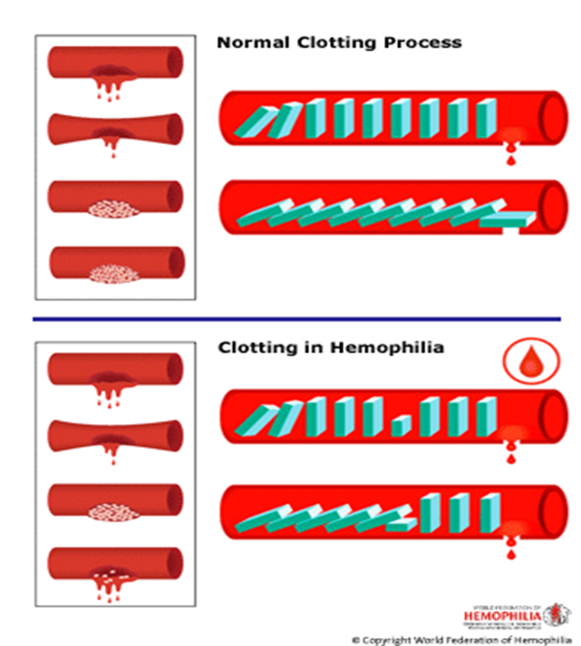
People with Hemophilia Bleed Longer, not Faster
They are missing or have low levels of a clotting factor – this makes it difficult for the blood to form a clot
Graphic Credit : World Federation of Hemophilia
Notes:
In people without hemophilia (the top picture), all the clotting proteins lined up to work together to form a clot.
In person with hemophilia (the bottom picture), one of the clotting proteins is missing or incomplete. The clotting process begins, but a person with hemophilia is unable to form a stable clot. This doesn’t mean they bleed faster – just that they bleed longer.

Slide 5
Incidence
Degrees of Severity
One in 7500 live male births
Affects approximately 17,000 males in the U.S.
All races and socioeconomic groups are equally affected
X-linked disorder, females carry gene, males are affected. 30% cases genetic mutations
Normal factor VIII or IX level = 50-150%
Mild hemophilia
  factor VIII or IX level = 6-50%
Moderate hemophilia
  factor VIII or IX level = 1-5%
Severe hemophilia
{Insert name} has severe hemophilia
  factor VIII or IX level = <1%
Notes:
Customize to say what degree of hemophilia your child has

Slide 6
Types of Bleeds
Joint bleeding
Muscle hemorrhage
Soft tissue - bruising
Life threatening - bleeding
Others - mouth, nose, scrapes, minor cuts
Notes:
Warn that we are about to show pictures of each

Slide 7
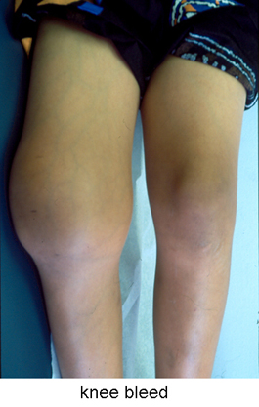
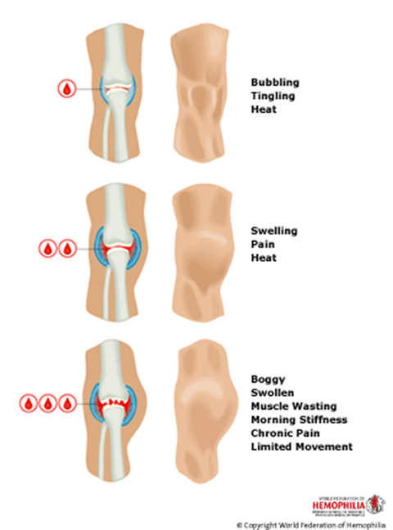
Joint Bleeding
Early signs of joint bleeding include bubbling, tingling and heat at the joint
(This is the best time to start treatment)
Swelling and pain set in
As the joint swells, it feels boggy, and range of motion is limited. Child may not be able to bear weight or move a limb. Very painful in later stages of a bleed
Knees, Ankles & Elbows most often affected
KEY POINT: Child can feel a joint bleed LONG before anyone sees any outward symptoms
Photo Credit: National Hemophilia Foundation
Graphic Credit : World Federation of Hemophilia
Notes:
In the picture, Point out the swelling, size and compare the right knee (which is bleeding) to left

Slide 8
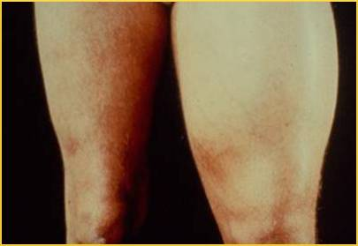
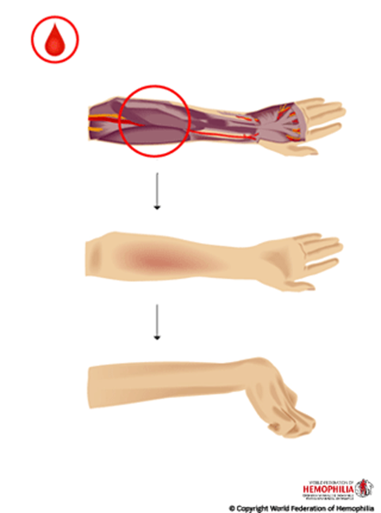
Muscle Bleeding
Signs and symptoms very similar to joint bleeding, but also can include tightness and/or shininess of skin
Muscle bleeding is very painful
Usually happens in arms and legs
Significant blood loss can happen quickly
Leg, thigh, calf, forearm and groin most affected areas
KEY POINT: Child can feel a muscle bleed LONG before anyone sees any outward symptoms
Graphic Credit : World Federation of Hemophilia
Notes:
Muscle bleeding is the second most frequent site of bleeding.
Any area of the body can be affected but frequently the extremities are involved. Large muscle bleeding can lead to nerve compression (i.e. iliopsoas, thigh - see picture). Significant blood loss can occur in large muscles before appreciable swelling is evident.
Bleeding into small muscles can also cause compartment syndrome (i.e. forearm, calf).
Signs and symptoms of muscle bleeding may include:
Vague ache or pain
Heat
Swelling
Inability/unwillingness to move muscle
Tightness of skin
Shininess in skin

Slide 9
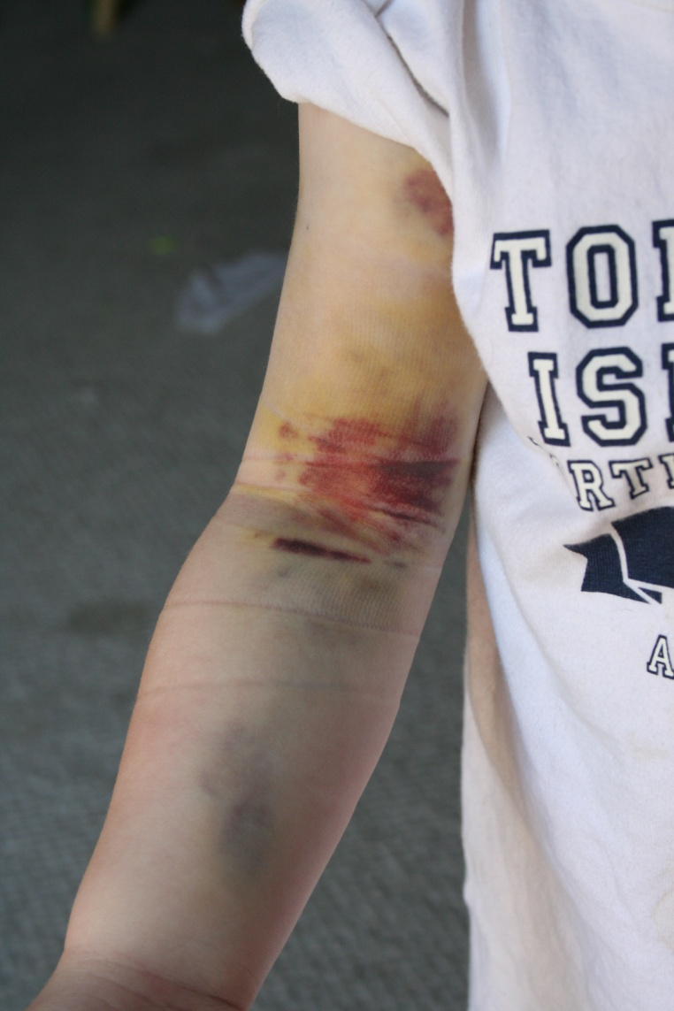
Soft Tissue Bleeding
Soft tissue bleeding is primarily characterized by bruising and hematomas (raised bruises)
Many children with hemophilia have significant bruising all over their bodies
Treatment is generally not needed, but ice can help with comfort
Graphic Credit : Wilkes family
Notes:
This slide illustrates common soft tissue bleeds in children. The child in the picture has a soft tissue bleed following a peripheral venipuncture. Applying firm pressure to a venipuncture site for several minutes will help prevent bleeding.
Bruises and hematomas are very common. Treatment is generally not required. Ice is often very effective.

Slide 10
Life-Threatening Bleeding
Head/Intracranial
  Nausea, vomiting, headache, drowsiness, confusion, visual changes, loss of consciousness
Neck and Throat
  Pain, swelling, difficulty breathing/swallowing
Abdominal/GI
  Pain, tenderness, swelling, blood in the stools
Iliopsoas Muscle
  Back pain, thigh tingling/numbness, decreased hip range of motion
Notes:
Need to call parents immediately if you notice any signs of these kinds of bleeds

Slide 11
Other Bleeding Episodes
Mouth bleeding
  Looks like more than it is, as it is mixed with saliva
  Child may vomit
  Feces may be black (from swallowed blood)
Nose bleeding
  Sit up, pinch bridge of nose, cool pack on back of neck
  If longer than 20 minutes, call parents
Scrapes and/or minor cuts
  Wash, pressure, dressing
  Call parents if bleeding persists

Slide 12
Treatment of Bleeding Episodes
Early and appropriate treatment of each bleeding episode is critical to minimize complications.
REPLACEMENT OF DEFICIENT CLOTTING FACTOR IS THE SINGLE MOST IMPORTANT STEP IN
ANY INTERVENTION
The recognition of bleeding episodes and treating bleeds as early as possible can help prevent complications such as the lost of range of motion, arthritis and muscle atrophy
Source: Butler. Basic Concepts of Hemophilia 2001; 3; 3.
Notes:
The goal of this slide is to get the school personnel to understand how vitally important early factor replacement is key to treating bleeding episodes.

Slide 13
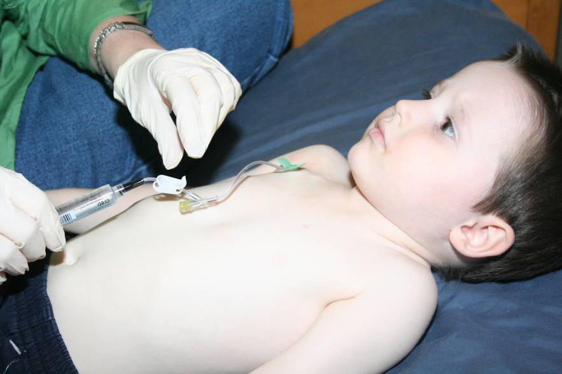
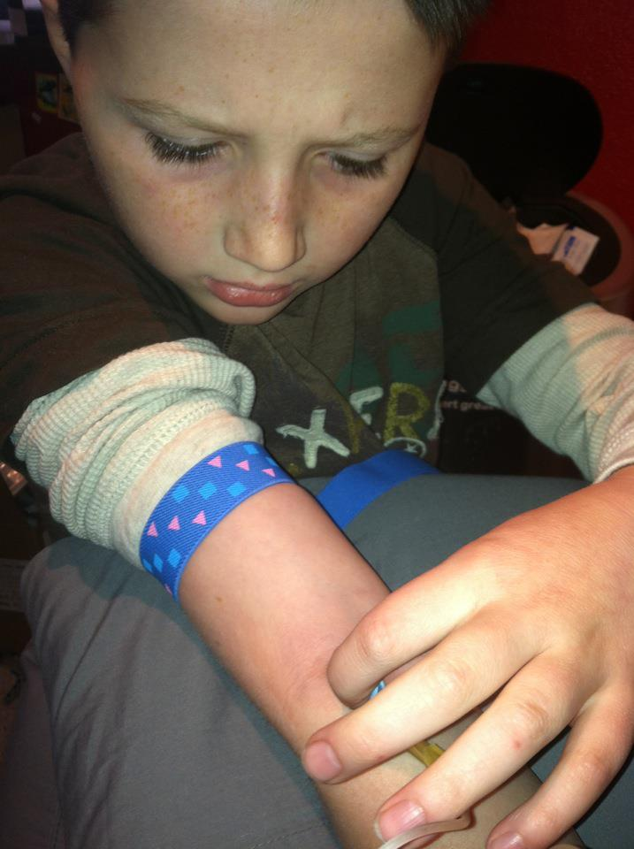
Factor Administration
Factor concentrate is administered intravenously (IV)
It should be administered as close to the time of the bleed as possible
In {insert child’s name}, factor is administered through {port or through a peripheral stick in his arm}
Notes:
Use this slide to talk about how your child infuses. Use the pictures already placed or use pictures of your child

Slide 14
What Does All This Mean in the School Setting?
Parents should notify the appropriate medical staff at the school about their child
Classroom teachers, PE/Gym teachers, playground supervisors should be aware that there is a child with hemophilia under their supervision
A care plan should be made with the medical staff, school personnel and parents
Key people should be made aware of the plan

Slide 15
Prophylaxis (or prophy)
People on prophylaxis infuse their treatment on a regular schedule to prevent bleeds from occurring. Prophylaxis is recommended for children with severe hemophilia.
There are two types of prophylaxis:
Primary – This type of treatment is usually started in young children to reduce or prevent joint disease and it is continued indefinitely.
Secondary – This type of prophylaxis is usually short term and it is started when a bleed has occurred and continued on a regular schedule for a defined period of time.
Advantages:
Reduced risk of joint damage
Ability to participate in sports and other physical activities
Reduced risk of spontaneous bleeding
{Insert Child’s Name} is on {fill in the blank} prophy schedule
Notes:
Disadvantages of prophy:
Frequent injections
Cost – Factor replacement is very expensive. An average prophylactic dose is 25 units per kilo. Each unit costs approximately $1. For example, an adult weighing 150 lbs., would inject 1,700 units per dose. This equals a cost of approximately $1,700 per dose.

Slide 16
How Does the Child Handle School?
Should not be treated differently than any other child in the classroom
Leave it up to the parents and/or the child to share with others that he has hemophilia
There are no learning disabilities that are associated with hemophilia
{Insert child’s name} could have frequent absences
  Hard to catch up
  Hard for peers to understand
Pain
  Could have acute or chronic pain
  Medication side effects
Notes:
Add anything here that is specific to your child

Slide 17
Activities
Unless recovering from a bleeding episode
  Should participate in regular gym class
  Should go on all planned field trips
  Should play at recess with classmates
Some activities restrictions
  No contact sports
  May need immobilization during or after a bleed
  May need some alternative activities for inclusion in physical education, recess, etc.

Slide 18
Bleeding at School
If a child says he is having a bleed or is limping or not using an arm
  Contact parents immediately
  Have the child elevate the body part that is bleeding
  Apply ice to the area
  Remember, the child can feel a bleed before there are any outward signs
Superficial cuts or scrapes
  Wash the area with an antiseptic soap
  Apply firm pressure
  Apply a dressing
  Contact parents if bleeding persists
Could have bleeding at port site

Slide 19
Meet {Insert Child’s Name}
Age
List siblings, names, ages, grade or school names
LIST DIAGNOSIS
i.e. Has severe Hemophilia A with a history of an inhibitor
LIST HOW FACTOR IS GIVEN
i.e. Has a port – venous access to infuse factor
Developmentally on target
Notes:
Customize this slide about your child!!! Add photos on the right hand side!
May want to mention your child’s factor schedule (i.e. “Little Johnny infuses on Monday, Wednesday, Friday and takes ___ units/kilo of factor VIII or IX via IV push. Parents will infuse Little Johnny before school on those mornings.” )

Slide 20
Things to Consider regarding {insert child’s name}
Can play along with other kids and do the same activities as others
Parents ask that he NOT run indoors or on cement.
Pay careful attention at recess & PE
No rough-housing with other kids
Playground
  Does not have to wear helmet as of now, but that could change
  Prefer that he only run on grass
  No running on cement
  No jumping off equipment
  Careful consideration when walking near swing
  Use equipment properly (no going up the slide, don’t come head first down slide, no jumping off play-sets, etc)
Notes:
Customize to your comfort level
Prefer that he not be excluded from activities, but intergraded in other manners. For example, he shouldn’t play dodgeball, but he can be the “watch” and help spot others who are tagged out.

Slide 21
Things to Expect
May be covered in excessive bruising
  Some older bruises may become lumpy or hard
May come to school “accessed”
  Needle inserted into his port. Will be covered by tape and his clothing
May come to school wrapped in ACE bandage or Coban, or other device
Medication will be kept in school building (nurse’s office)
Notes:
Insert pictures on right hand side – maybe of your child in some of these situations – ACE Bandage, with bruises, etc.
It’s possible he may missed school due to bleeding episodes. The parents agree to communicate with school to facilitate make up work, etc.
He may also come to school using assistive devices. It’s possible he could be in a wheelchair, on crutches, etc.

Slide 22
How Much do Others Need to Know?
If other parents ask about {insert child’s name}, they can be told:
  He has a medical condition
  He has Hemophilia
  He has a bleeding disorder
Encourage them to talk to {insert child’s name} parents if they have more questions. We welcome the opportunity to give them more information.
If the kids notice bruising, helmet, Medic-Alert bracelet:
  {Insert Child’s Name} can tell the other kids :
    “I have special blood”
    “My blood doesn’t work right”
    “I’m missing something in my blood”
    “I get pokes”
    “I get infusions”
Notes:
You have to decide what’s right for your family in terms of disclosure to persons other than school personnel (other parents and students). If you or your child are not comfortable disclosing to others, you can delete this slide.

Slide 23
Parent’s Key Concerns
Treat him normally
  Don’t label him
  Don’t overprotect
  Don’t exclude him
  Don’t overreact
Believe him if he says something hurts
CALL if you have any questions!
Notes:
Add any other concerns you have here

Slide 24
When to Call Parents
If {insert Child’s name} says something hurts
Fever
Injury to joints
ANY head or neck injury
Non use of a limb or swelling, warmth or redness in a limb
Broken bone
Cut requiring sutures
Injury to torso (especially chest wall) or kidney area
Notes:
If your child has a port, stress that it’s extremely important to call the parents immediately. A fever is a sign of a possible port infection which can be life threatening. Fevers must be thoroughly checked with blood culture to determine the cause of the fever.
Be sure to note: The parents will ask questions to determine how a bleeding episode started or how the injury occurred. Do not mistake this questioning as blaming – it’s only so the parents can help the medical providers determine the best course of treatment.

Slide 25
Responsibilities
Student
Parent
Learn to communicate
Tell someone when they are bleeding
Do your schoolwork on time
Make the same amount of effort as someone without hemophilia
Communicate child’s condition, activity level & treatment
Help obtain makeup work
Help the child have a positive attitude about school
Work with school staff & nurse to develop a factor treatment plan
School
Monitor student achievement & inform parents of any change to personality, performance
Communicate to parent/child any observable sign of a bleed
Stress the importance of completing assignments
Promote ability and success, not inability
Respect privacy and confidentiality

Slide 26
Conclusions
Remember that {insert child’s name} is a normal child who happens to have a bleeding disorder
Understand what type of bleeding disorder {insert child’s name} has and the type of treatment he receives
Have an emergency plan in place
If you have questions or have ANY questions, ANY time, call the parents!

